Slide 1
Room-side Troffer ODM
Steve Reich, 4/10/2020

Slide 2
Scope
Cree lighting is looking for:
Design Engineering and production tooling for the sheetmetal components of our new troffer lineup
This Includes
Backpans
Endpanels
Center LED trays
Not included
Plastic injection molded endcaps
Extruded diffusion lenses

Slide 3
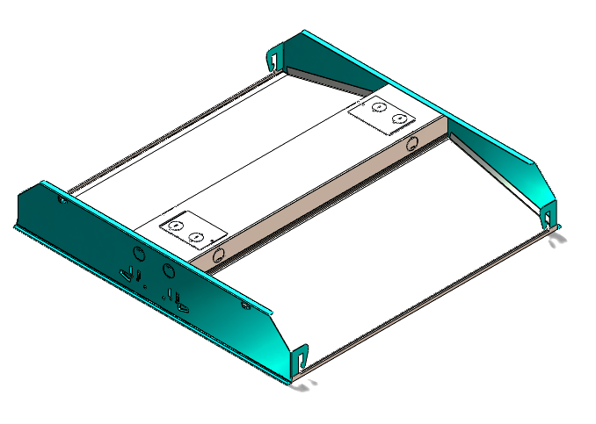
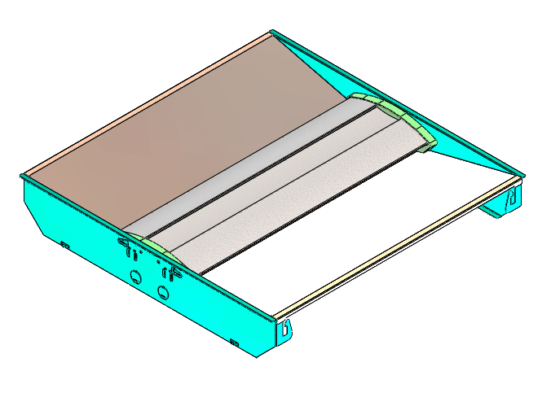
Troffer Overview

Slide 4
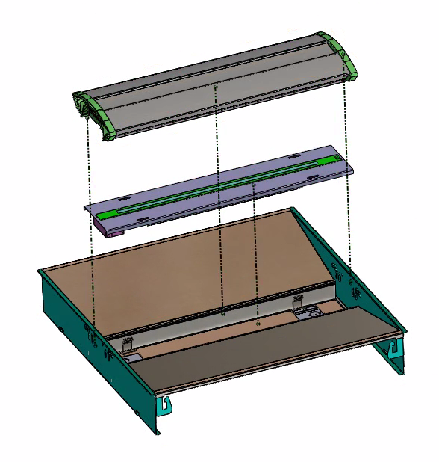
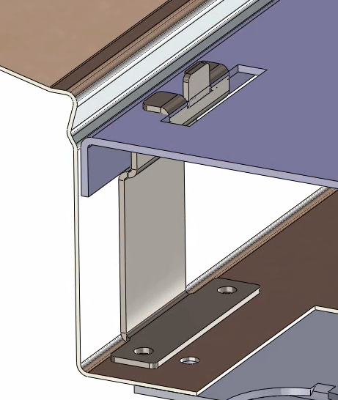
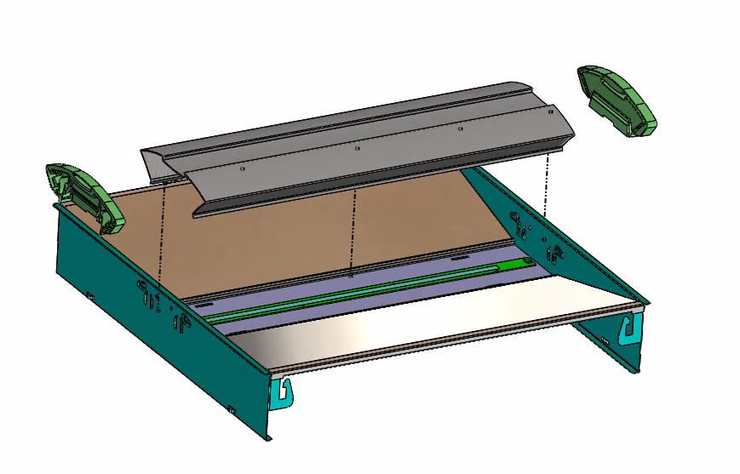
Troffer Features - Front
Removable LED/Driver Tray
All lens and end cap options designed and produced by CREE Lighting
All sheet metal and retention clips designed by turnkey provider.
Removable Lens
Removable End Caps
Removable End Caps
Quick Release, Tool-less Retention Clips
Notes:
Clip is just a concept. Require ODM to put more thoughts on suppliers to solve the issue. Does not depend on clip contact (thermal resistance). Make them aware of the thermal issue. Internal: mock-up test/sheet metal. Additional thermal relief onto the driver/EB. LED shall be fine. How often (i.e., 10 times) replacement.
Identify the worst thermal combo for testing. Identify the ODM/turnkey supplier. Provide high level requirement & concept. Have supplier work out the details. Worst case weight on Ebom (30% margin). Get quote or requirement template from OEM/ODM team. Provide mini gauge size for tray/panel/pan per UL standard. Prefer the same gauge in the end panel of the same fixture. Based on existing FLX design. Start off FLX.
Check with Dana. Have supplier. Provide “Weight & Thermal” specs.
Pre-painting vs powder coating. Color matters over the paint method. Mounting LED driver is not specified (hole & screws are fine, no shadows).

Slide 5
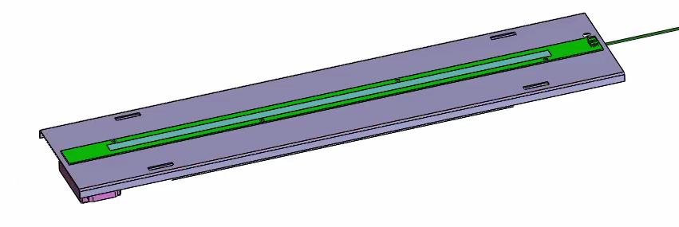
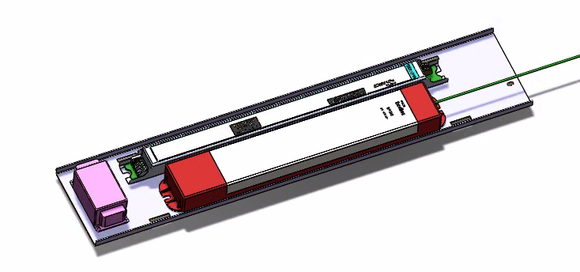
Troffer Features - Front
LED/Driver Tray
LED Board
LED Linear Driver
347V Transformer
Emergency Backup
Generator Transfer
Additional Accessories

Slide 6
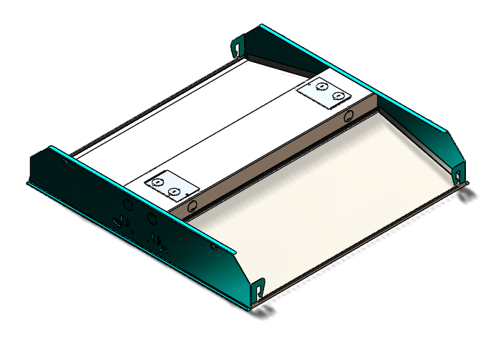
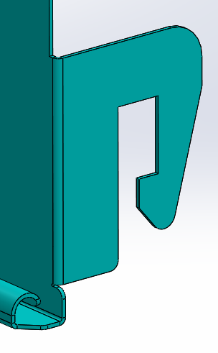
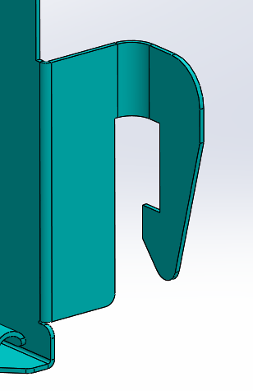
Troffer Features - Back
T-Grid Integrated Clip
Standard
Bent

Slide 7
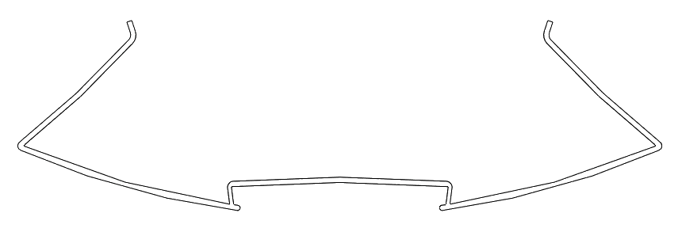
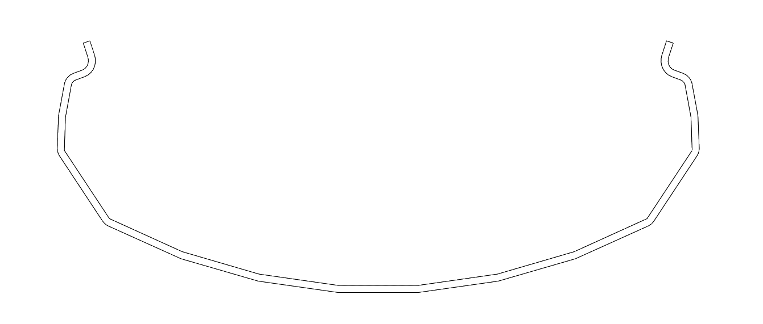
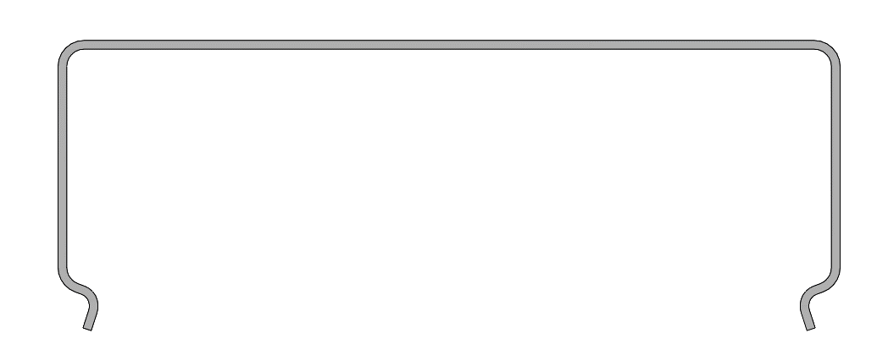
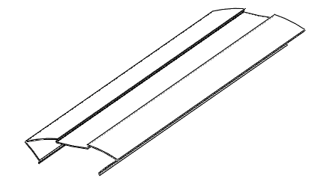
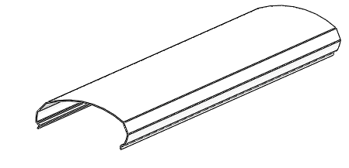
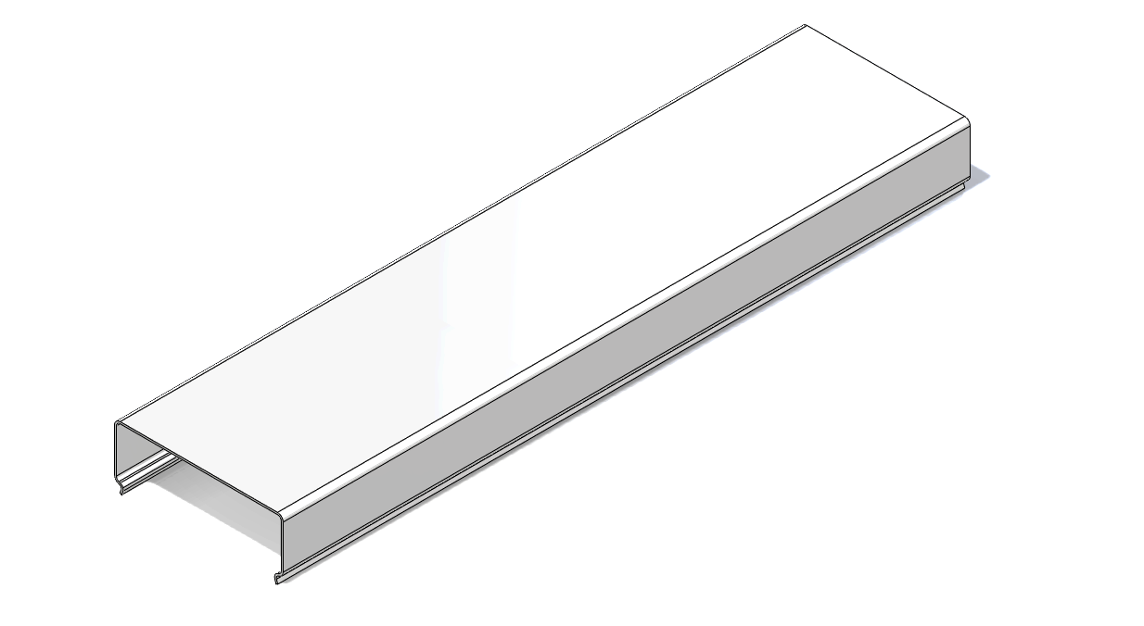
Troffer Features – Lens Options
All lens options designed and produced by CREE Lighting
Arch
Round
Square

Slide 8
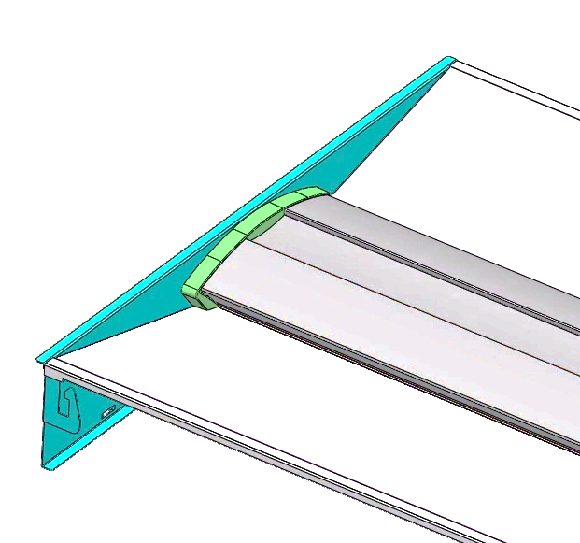
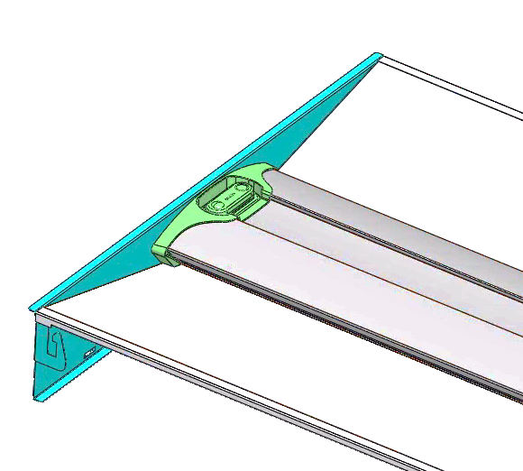
Troffer - End Cap Options
Arch End Caps
Wireless Lutron VIVE or CREE WIM
Standard (Not Wireless)

Slide 9
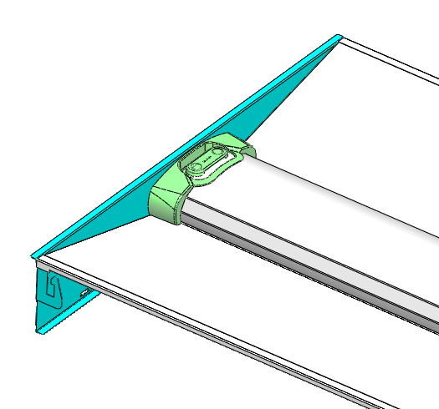
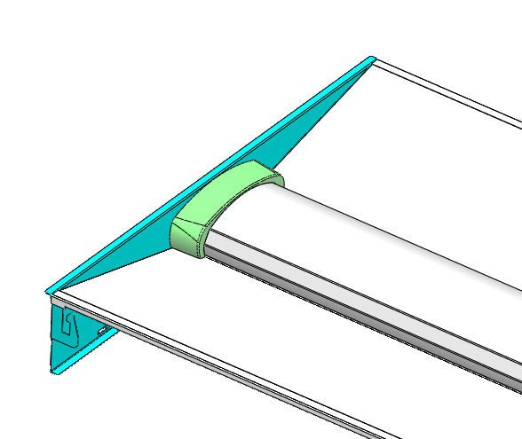
Troffer - End Cap Options
Round End Caps
Wireless Lutron VIVE or CREE WIM
Standard (Not Wireless)

Slide 10
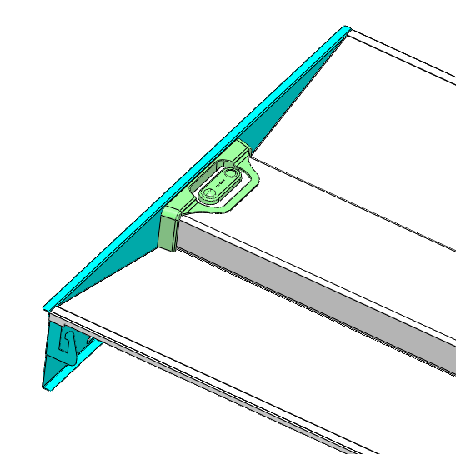
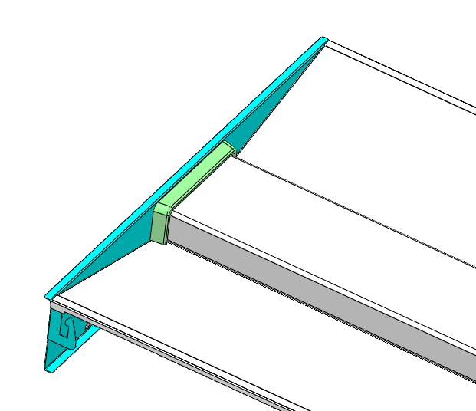
Troffer - End Cap Options
Square End Caps
Wireless
Lutron VIVE or CREE WIM
Standard (Not Wireless)

Slide 11
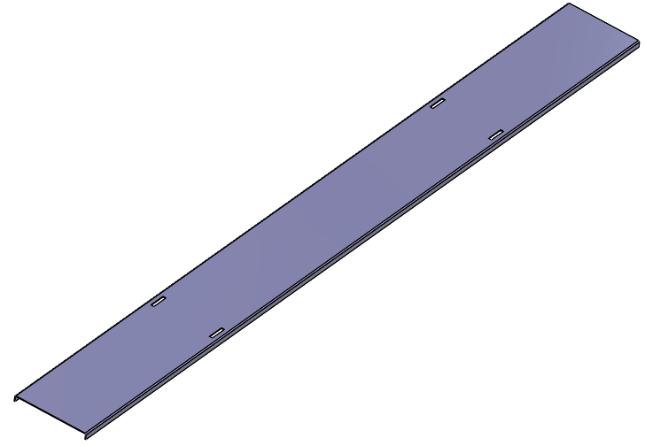
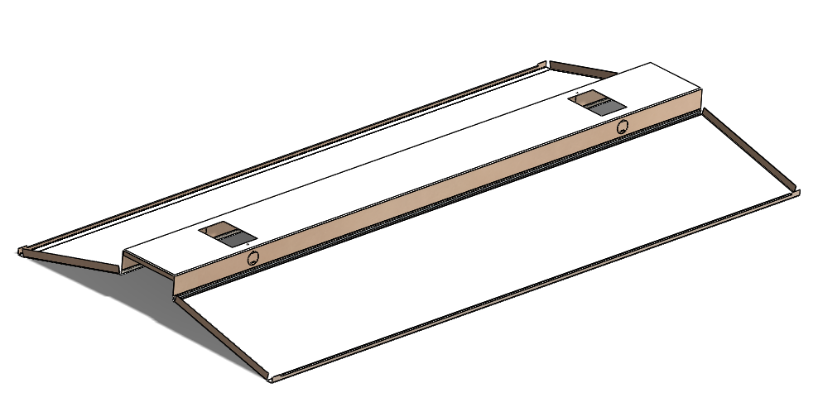
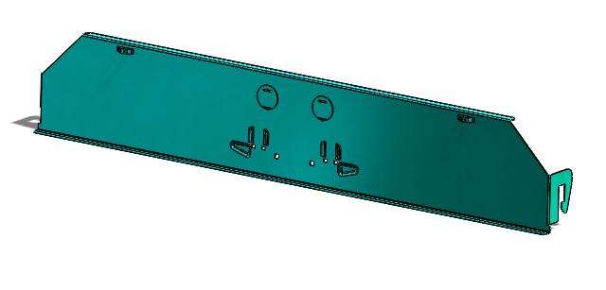
Parts up for Bid for design by turnkey provider
End Panels 2pcs/fixture
1x4 Version
2x2/2x4 Version
Back Pan
1x4 Version
2x2 Version
2x4 Version
Removable Tray Assembly
2x2 Version
1x4/2x4 Version
Associated assembly components

Slide 12
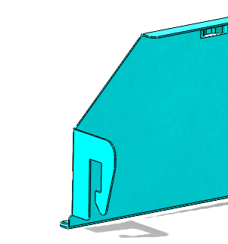
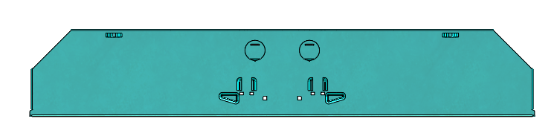
Design Features – End Panels
Features Required
(Flexible Design)
Chamfer all sharp edges
2X ½” Trade Knockout
Locate approx. as shown
Features Required
(Locked Design)
Details to be furnished in design package
Features Required
(Semi-Flexible Design)
Details to be furnished in design package
Notes:
Suspending holes (upper left features), position. Strength based on UL requirement

Slide 13
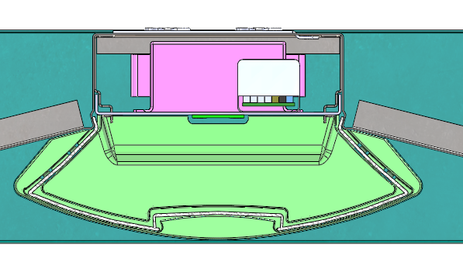
Design Features – Pans
2X Access Cover Locations
Must accept existing P/N LHD00752X
Features Required (Design Flexible)
1.50” Requirement
Features Required
(Flexible Design)
Overall Fixture Height = 4.10” MAX
4X ½” Trade Knockout
Locate approx. as shown
Pan angles must be maintained. Angles shall be furnished as part of design package

Slide 14
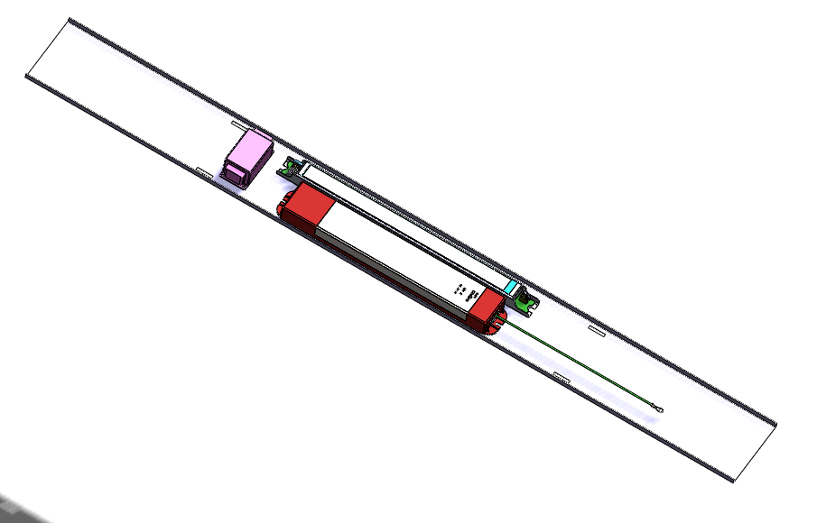
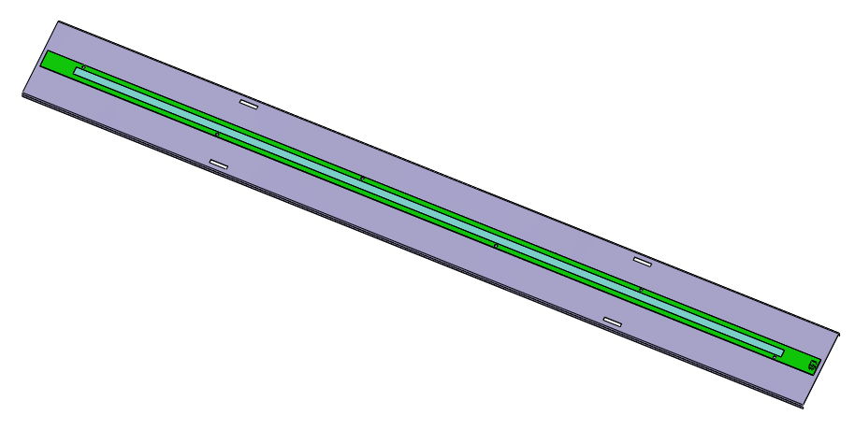
Design Features – Removable Tray
Actual Driver, EB and Accessory matrix shall be conveyed with design package (Design Flexible)
Removable tray design for integration with retention clips (Design Flexible)
2X Detachable & Tool-less Safety Tethers
Features Required (Design Flexible)
Design package shall have LED board mounting locations and physical extents

Slide 15
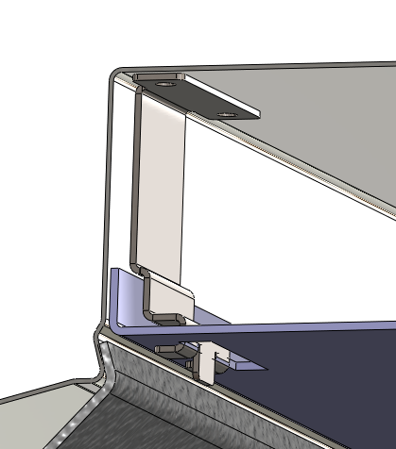
Design Features – Removable Tray
Quick Release Assembly Requirements
Must be tool-less
Safety tethered on back side
Completely removable from room-side
Quick disconnects for any wire harnesses
Safely support the weight of LED Driver, EB and Transformer
Cannot interfere with existing lens profiles
Cannot create shadows on lens
Removable Assembly Suggestions
Hardened steel quick release clips
Slot+Tab lanced sheet metal between tray and pan
Slide locking action
Side hinged action
Quick Release Assembly
Features Required (Design Flexible)

Slide 16
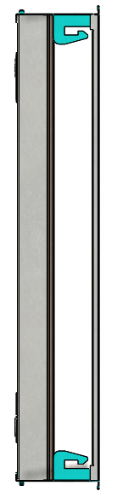
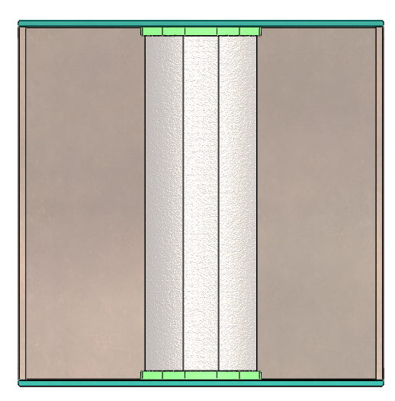
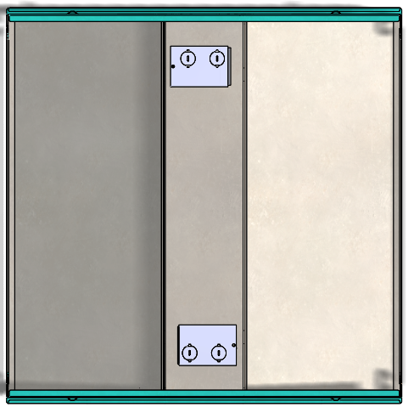
2X2
104mm/4.1”
603mm/ 23.7”
604mm/ 23.8”
Top
Side
Front

Slide 17
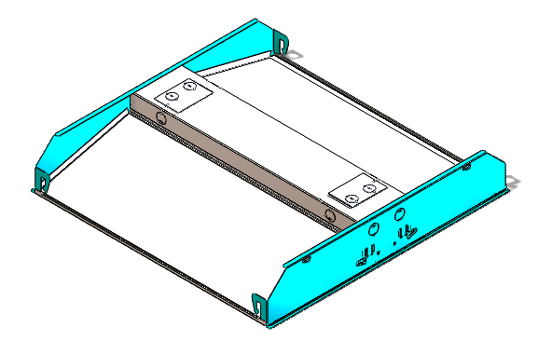
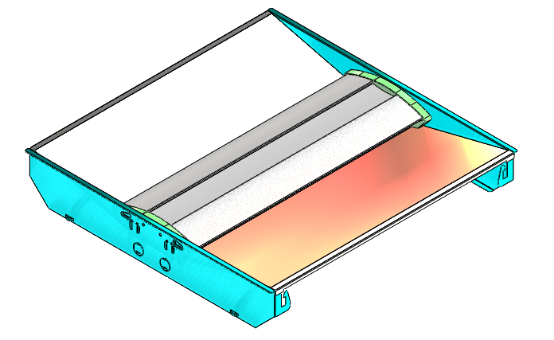
2X2

Slide 18
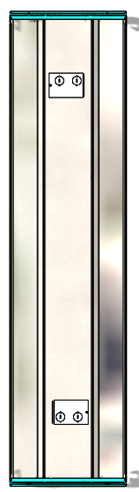
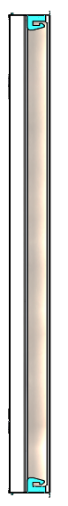
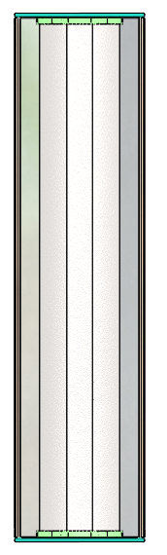
1X4
104mm/4.1”
298mm/11.8”
1,213mm 47.8”
Top
Side
Front

Slide 19
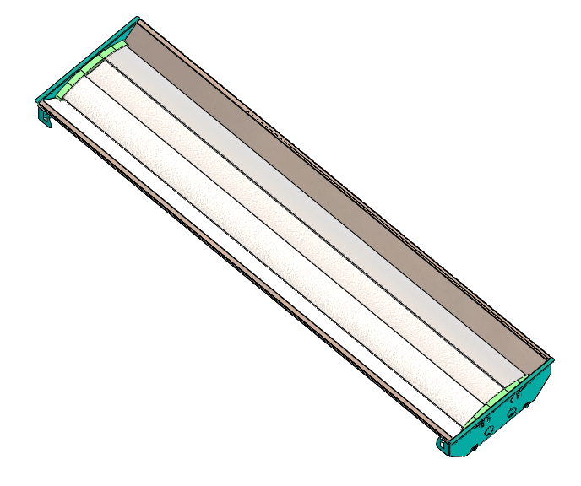
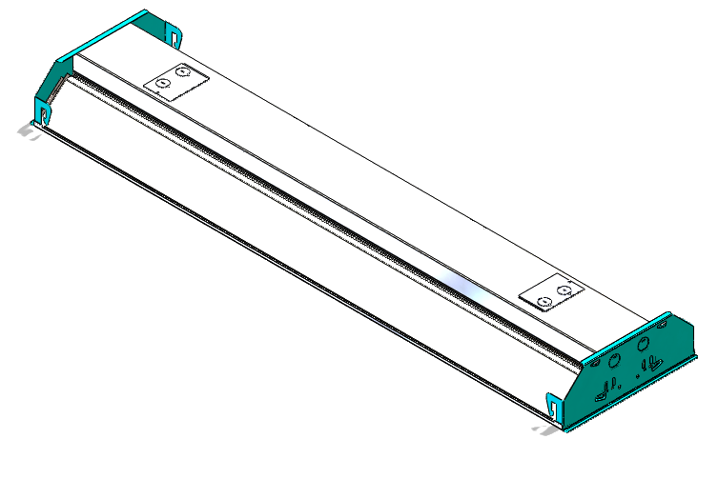
1X4

Slide 20
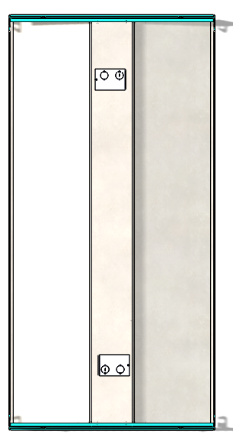
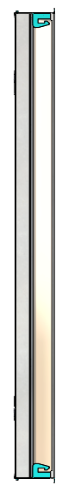
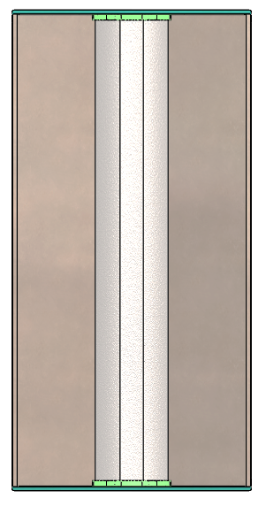
2X4
104mm/4.1”
603mm/23.7”
1,213mm 47.8”
Top
Side
Front

Slide 21
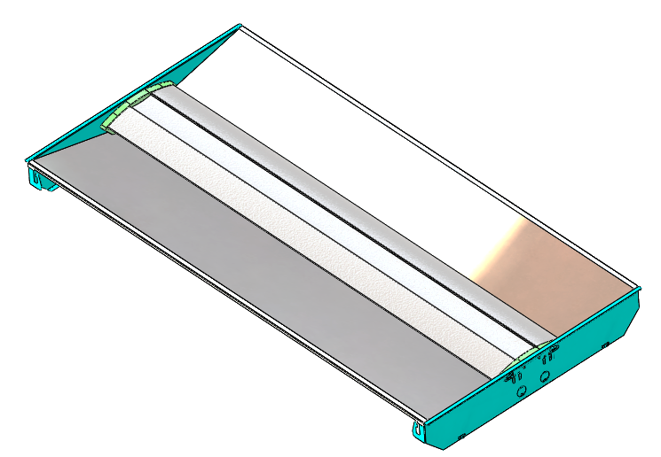
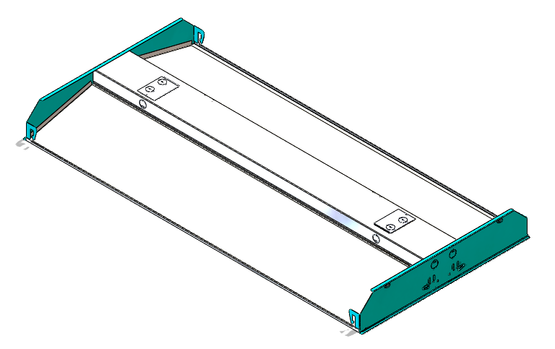
2X4

Slide 22
Design package details
Beyond the design details in notes (in red previously)
PRS details for driver/EB/accessory options
Any pertinent thermal constraints for the driver enclosure portion

Slide 23
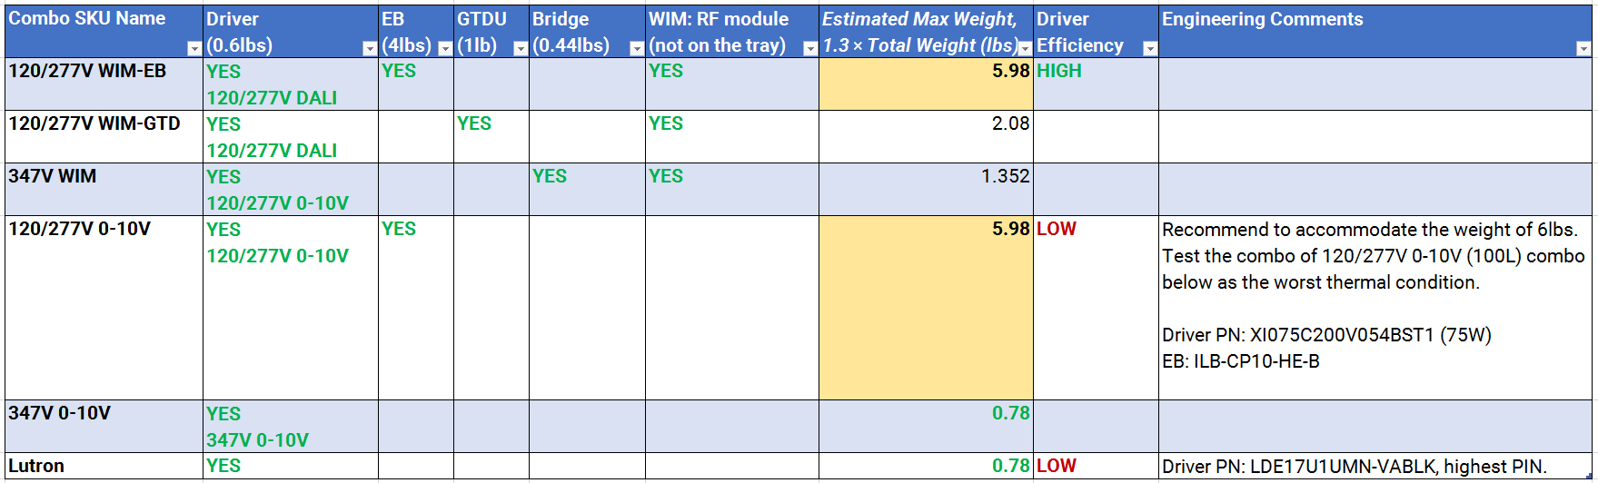
Electrical Components on the LED/Driver Tray
Last Update: 4/14/2020
EE: Qingcong Hu
Sys Eng: Frank Fang
This slide identifies the critical electrical components that need to be mounted on the driver side of LED/Driver tray. It includes 1) LED driver, 2) EB driver, 3) GTDU, 4) SR bridge. Here is the guidance.
Design mounting options on the LED/driver tray to enable the combos below.
Meet the UL compliance requirement handling the max weight.
Test the worst thermal condition (red arrow).

